Slide 1
Instagram User Analytics
By : Hanif Mohammad

Slide 2
Contents
01
02
03
04
05
Project Description
Approach
Tech-Stack Used
Insights
Result

Slide 3
Project Description
Generating business insights that teams around the organization can use to monitor app performance through user engagement and enhance the user experience overall. By analyzing metrics such as user registration patterns, post frequency, and potential fake accounts and by providing actionable information to the product team.

Slide 4
Approach
Database Creation:
The initial phase of the project involved setting up the database by executing the DDL and DML SQL queries provided by the product manager. This process was carried out in MySQL Workbench to ensure the accurate creation.
Extraction of Insights:
After creating the database required insights are generated from the database tables by running SQL queries in MySQL workbench. Each query is written with precision to ensure efficiency and accuracy for the marketing and investor metrics tasks.

Slide 5
Tech-Stack Used
The tech stack used for the Instagram User Analytics project included MySQL Community Server, GPL Version 8.0.37, and Connector, C++ Version 8.0.29. MySQL Community Server is a free and open-source relational database management system that utilizes SQL for data analysis and management.

Slide 6
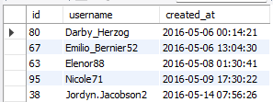
Insights: Marketing Analysis
The 5 oldest users of the Instagram from the database are:
1. Loyal User Reward:
Those who have used the platform for the longest period of time.
Query :
SELECT id, username, created_at FROM users
ORDER BY created_at LIMIT 5;

Slide 7
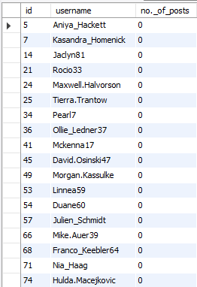
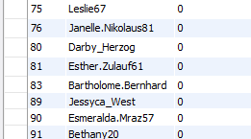
Insights: Marketing Analysis
The users who have never posted a single photo on Instagram
2. Inactive User Engagement:
By sending them promotional emails to post their 1st photo.
Query :
SELECT u.id, u.username,
Count(p.user_id) AS 'no._of_posts'
FROM users u LEFT JOIN photos p ON u.id = p.user_id
GROUP BY u.id HAVING Count(p.user_id) = 0;

Slide 8

Insights: Marketing Analysis
Details of the winner of the contest are:
3. Contest Winner Declaration:
The team announced a competition in which the person with the most likes on a single image would win. They now want to announce the winner.
Query :
SELECT id, username FROM users
WHERE id = (SELECT user_id
FROM photos
WHERE id = (SELECT photo_id
FROM likes
GROUP BY photo_id
ORDER BY Count(photo_id)
DESC LIMIT 1));

Slide 9
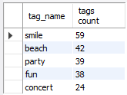
Insights: Marketing Analysis
The top 5 most commonly used hashtags on the platform are
4. Hashtag Research:
In order to attract the greatest number of users on the platform, a partner business is interested in knowing which hashtags to include in the post.
Query :
SELECT t.tag_name,
Count(t.tag_name) AS "tags count"
FROM tags t
INNER JOIN photo_tags ph
ON t.id = ph.tag_id
GROUP BY t.tag_name
ORDER BY Count(t.tag_name) DESC
LIMIT 5;

Slide 10

Insights: Marketing Analysis
Day of the week do most users register on :
5. Ad Campaign Launch:
The team is working on figuring out which day is best to start advertising.
Query :
SELECT Dayname(created_at) "day of week",
Count(Dayname(created_at)) "count of users registered"
FROM users GROUP BY Dayname(created_at)
ORDER BY Count(Dayname(created_at))
DESC LIMIT 2;

Slide 11

Insights: Investor Metrics
Average user posts and ratio of total posts to total users are:
1. User Engagement:
Do users still post on Instagram and remain active, or are they posting less frequently?
Query :
SELECT (SELECT Count(id)
FROM photos) / (SELECT Count(DISTINCT user_id)
FROM photos)
AS Average_posts_per_User,
(SELECT Count(id)
FROM photos) / (SELECT Count(id)
FROM users)
AS Ratio_of_Total_Posts;

Slide 12
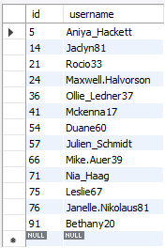
Insights: Investor Metrics
Users who have liked every photo on the site (since normal users can't do that) are:
2. Bots & Fake Accounts:
Investors are interested in knowing if there are a lot of fake and false accounts on the site.
Query :
SELECT id, username FROM users
WHERE id IN (SELECT user_id FROM likes
GROUP BY user_id
HAVING Count(user_id) = (SELECT Count(id)
FROM photos));

Slide 13
Results :
Conclusions :
Through this project, We successfully utilized SQL queries to extract valuable insights from the Instagram user database, providing actionable information for various business teams. The analysis enabled the identification of the most loyal users, inactive users, contest winners, and popular hashtags, which can inform marketing strategies and product development decisions.
Here are a few key conclusions from the Instagram User Analytics project:
Utilize user engagement insights to optimize marketing campaigns and drive platform growth.
Leverage data on loyal users, inactive users, popular hashtags, and peak registration days to enhance marketing strategies.
Monitor user engagement metrics as valuable indicators of platform health and success.
Identify and remove bots/fake accounts to improve overall user experience and trust.

Slide 14
Thank you

